Slide 1
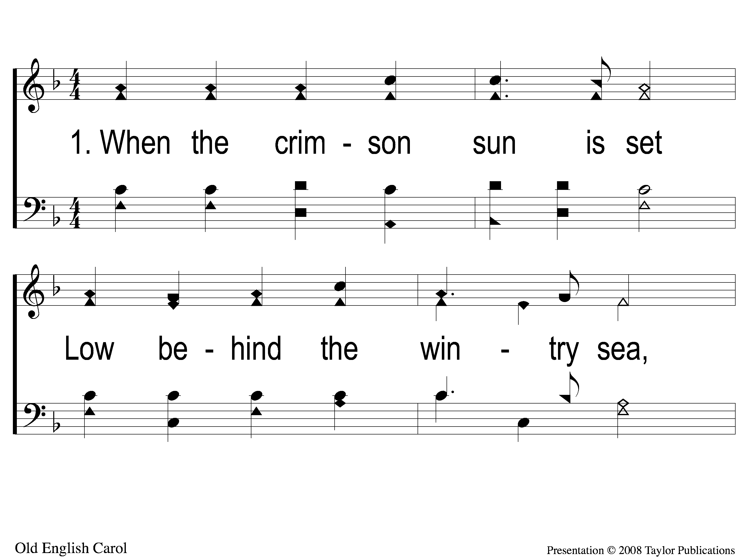
1-1 When the Crimson Sun is Set
When the Crimson Sun is Set
68

Slide 2
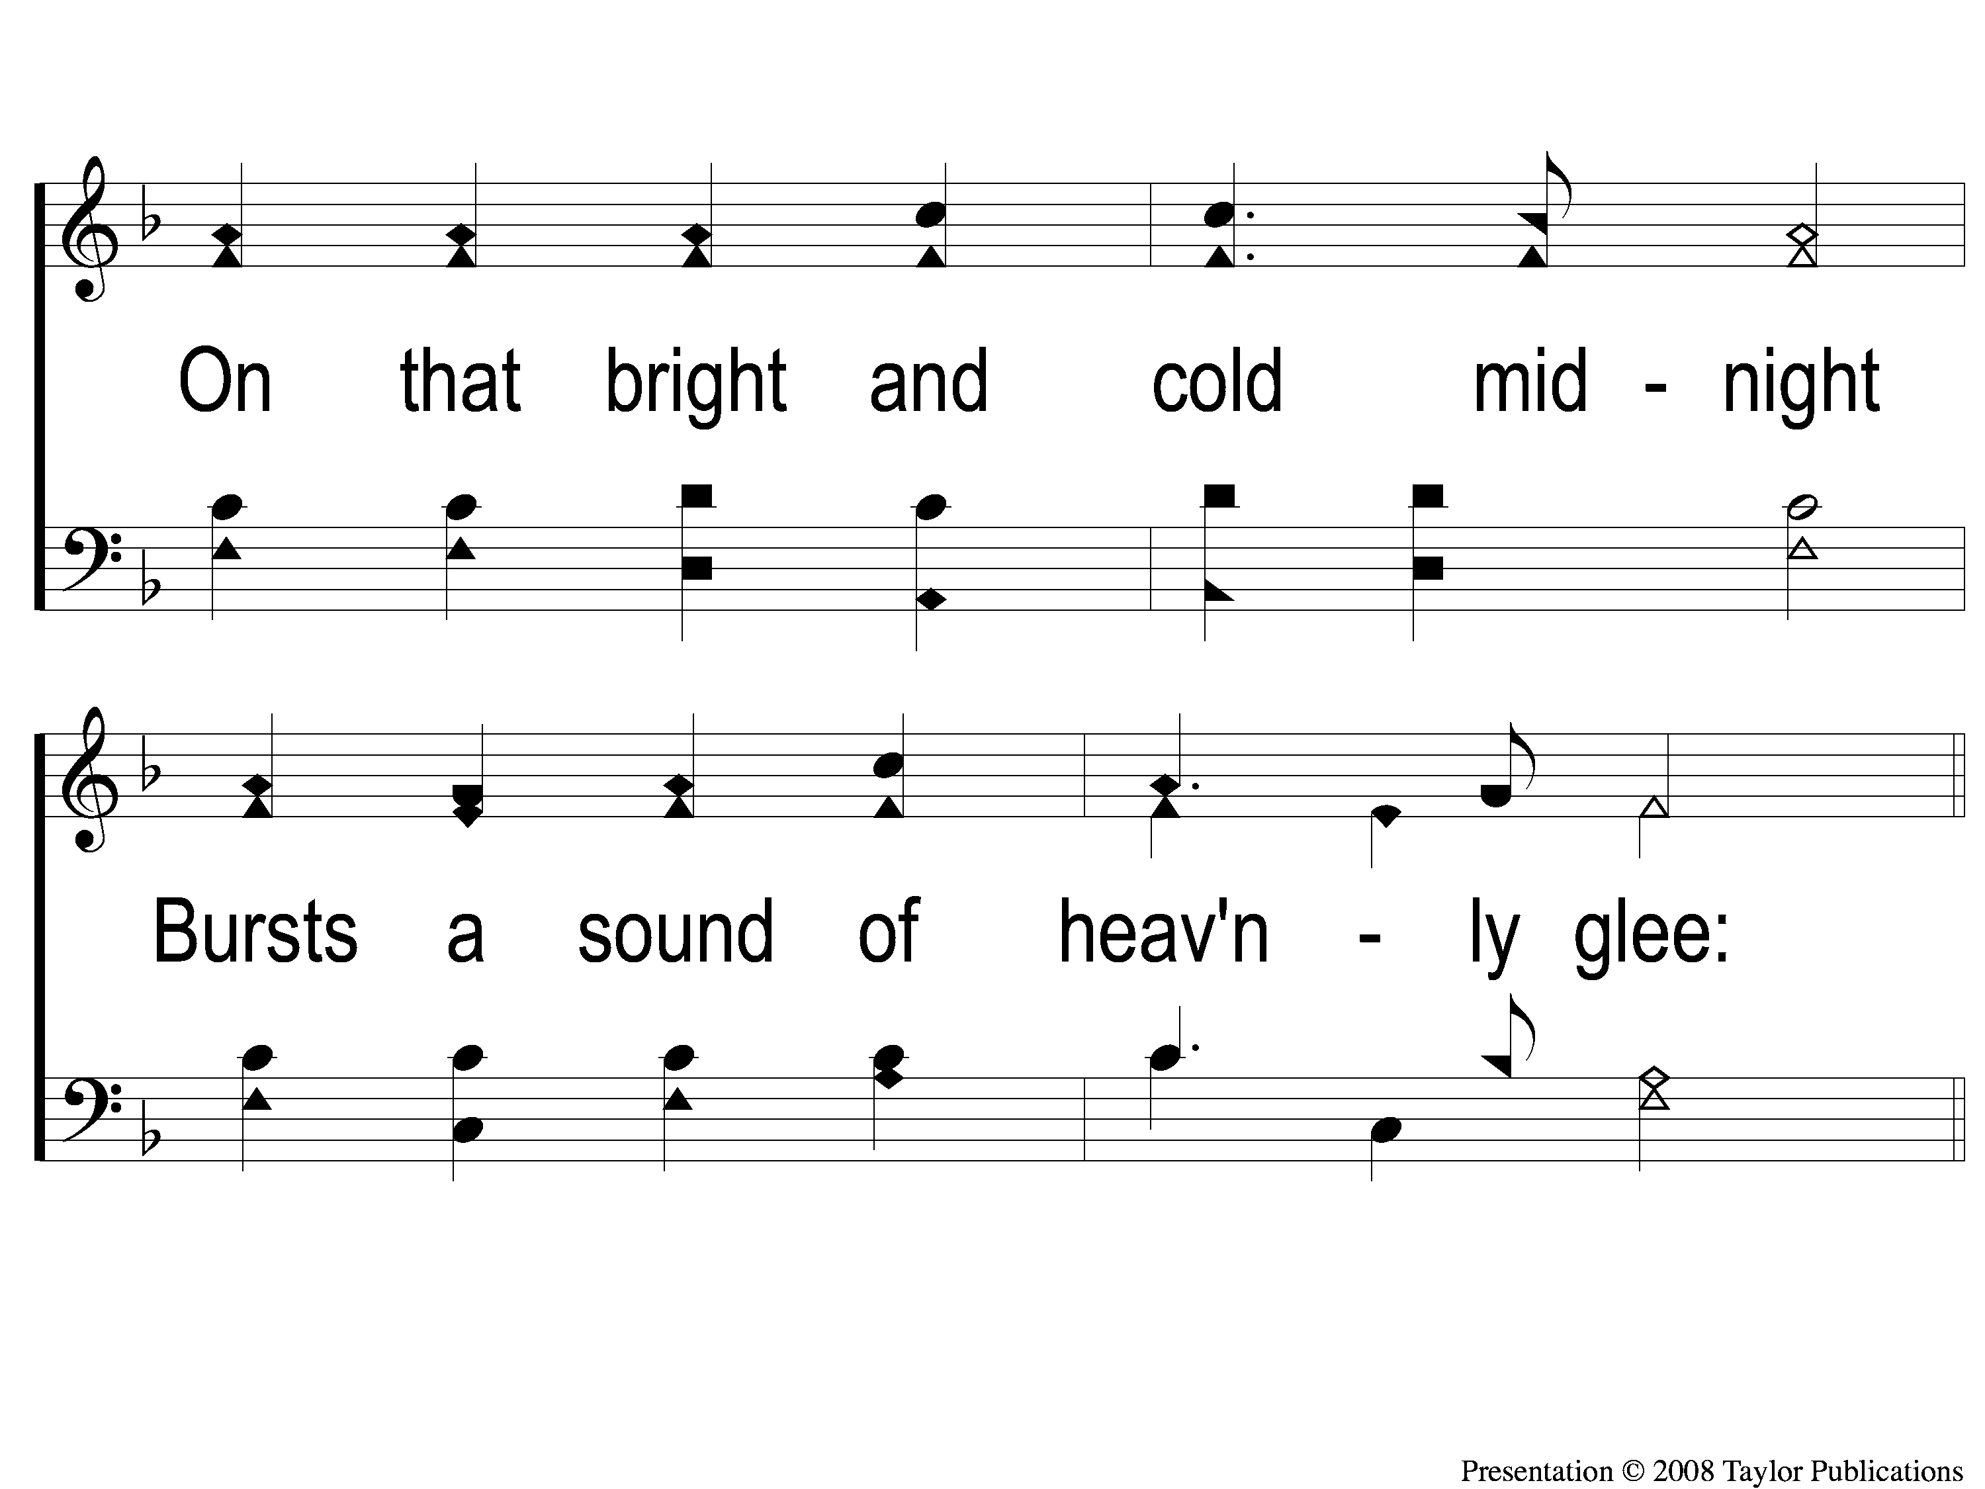
1-2 When the Crimson Sun is Set
When the Crimson Sun is Set
68

Slide 3
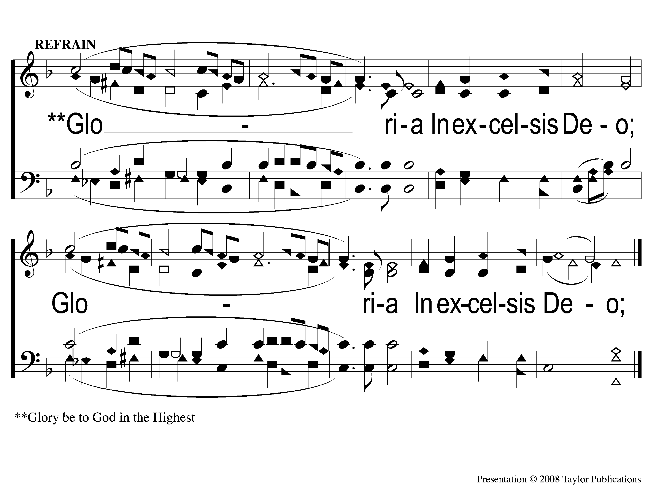
C When the Crimson Sun is Set
When the Crimson Sun is Set
68

Slide 4
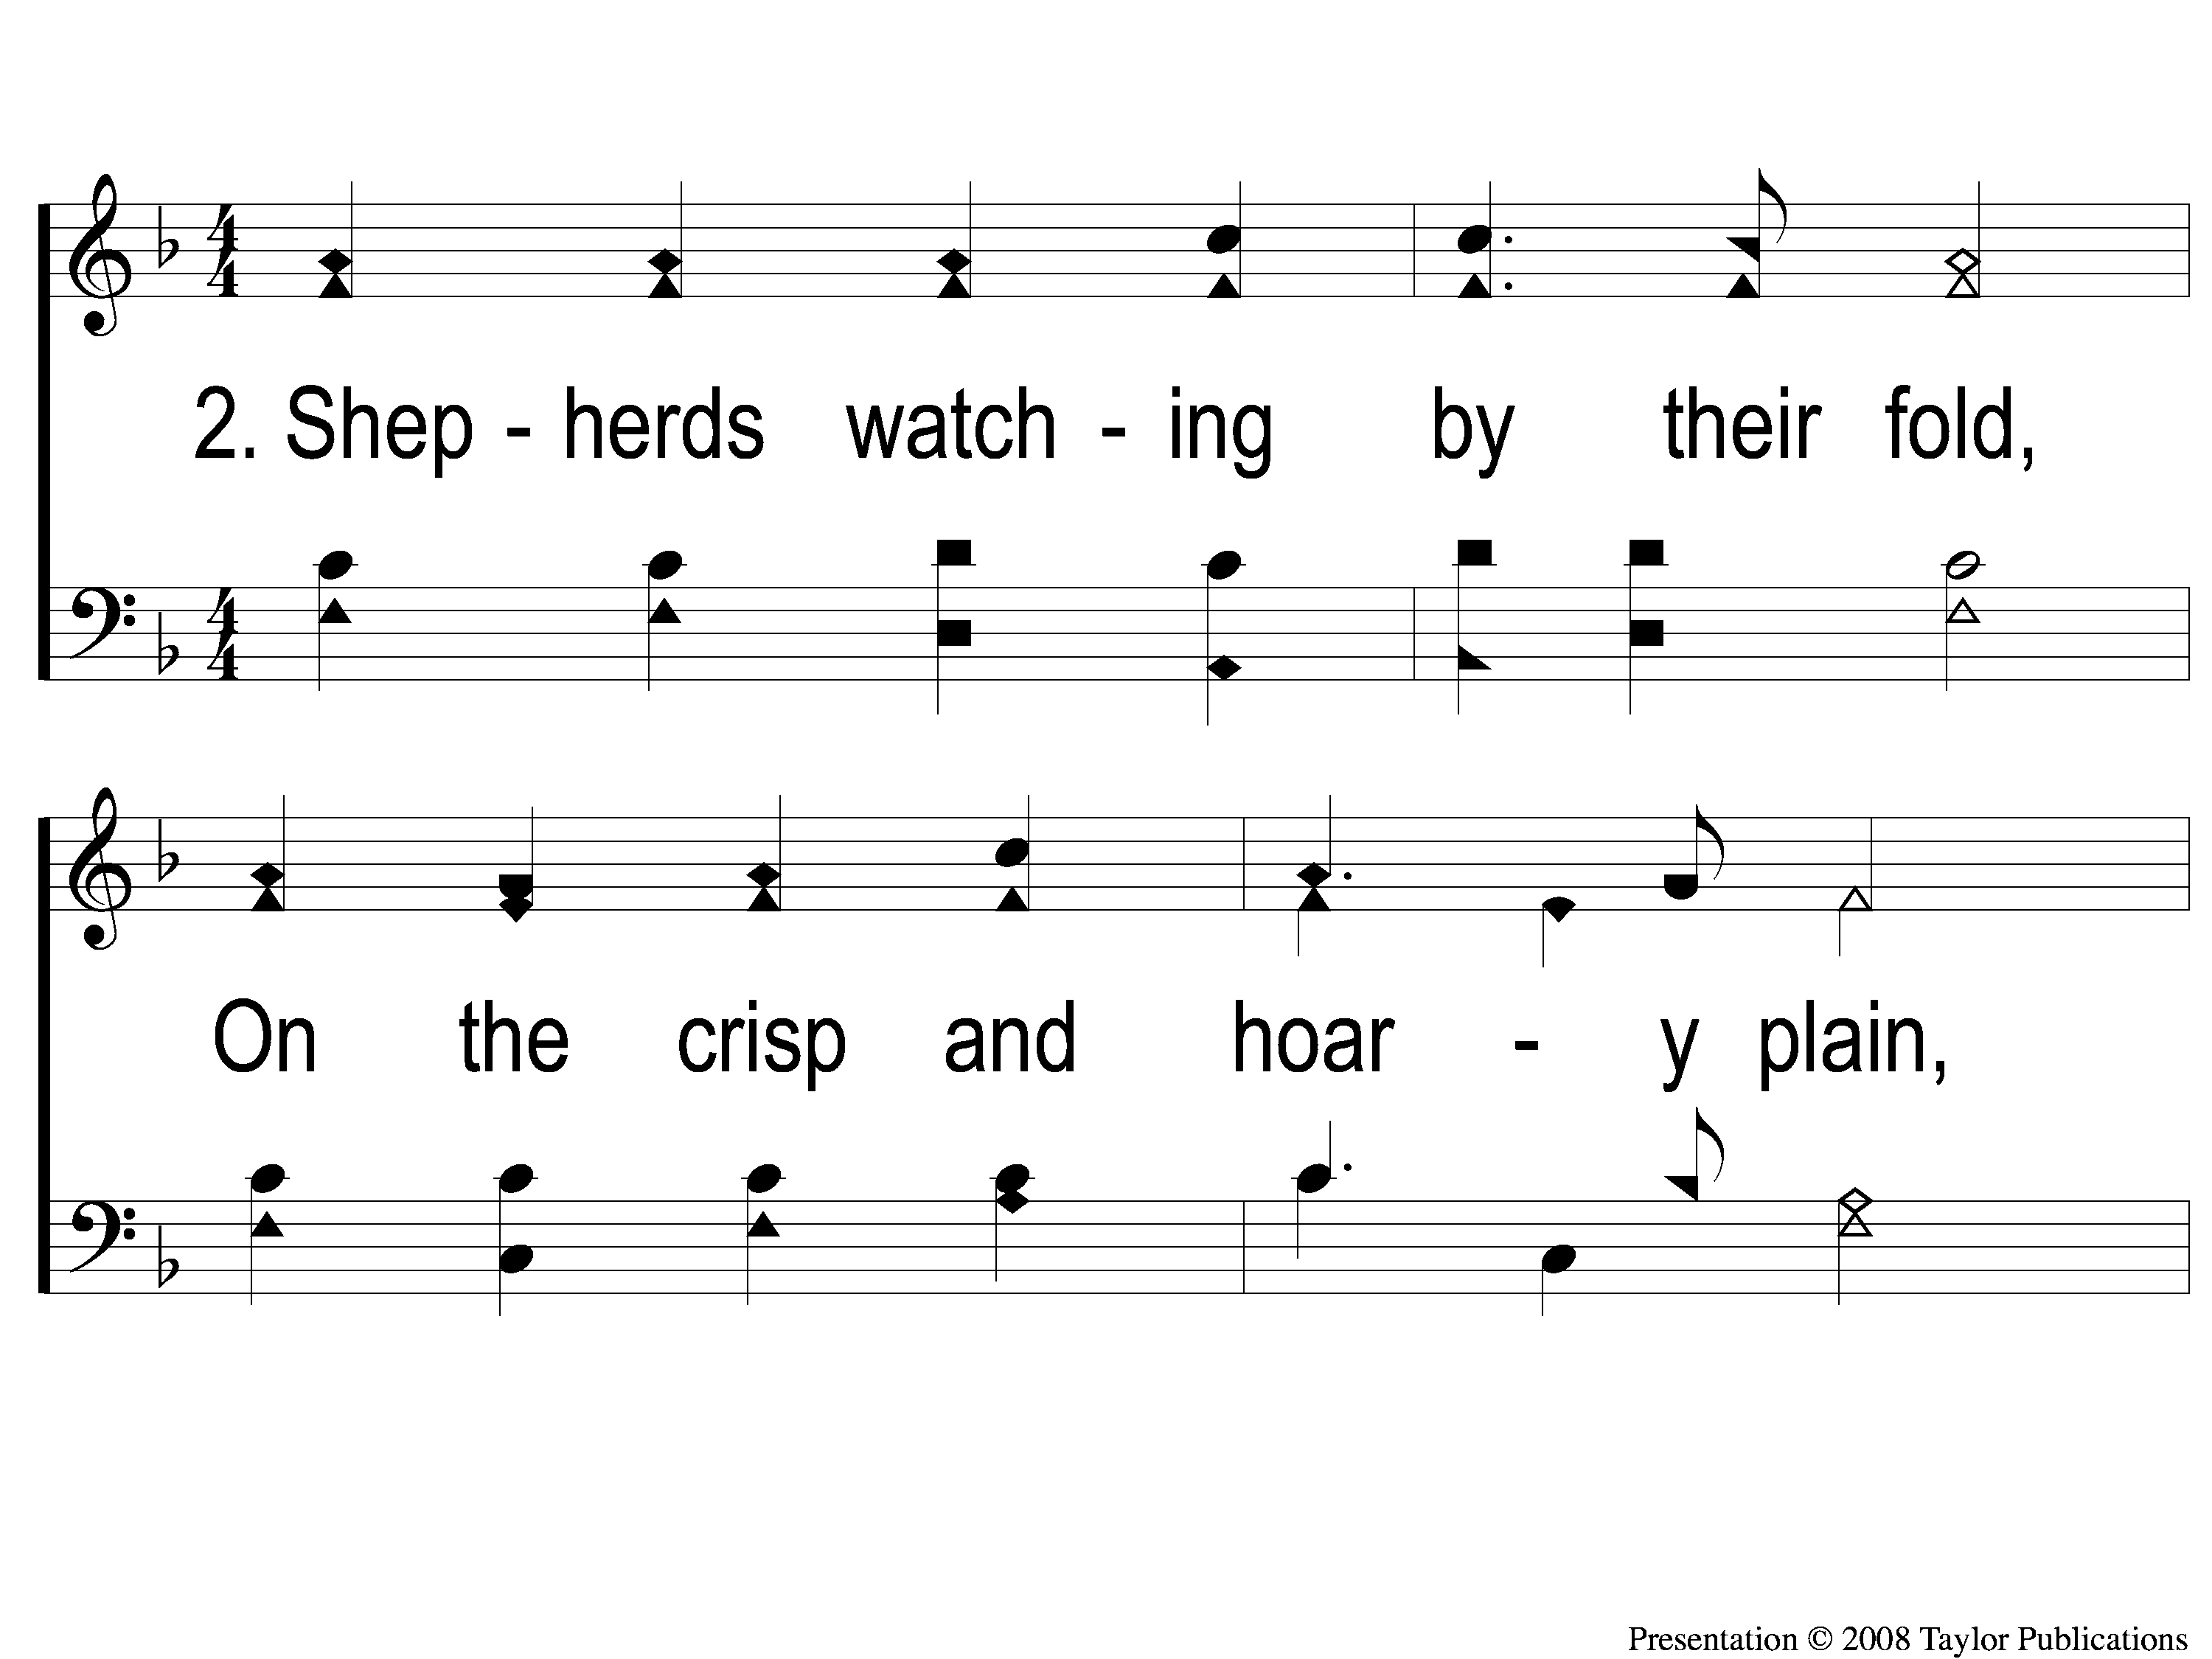
2-1 When the Crimson Sun is Set
When the Crimson Sun is Set
68

Slide 5
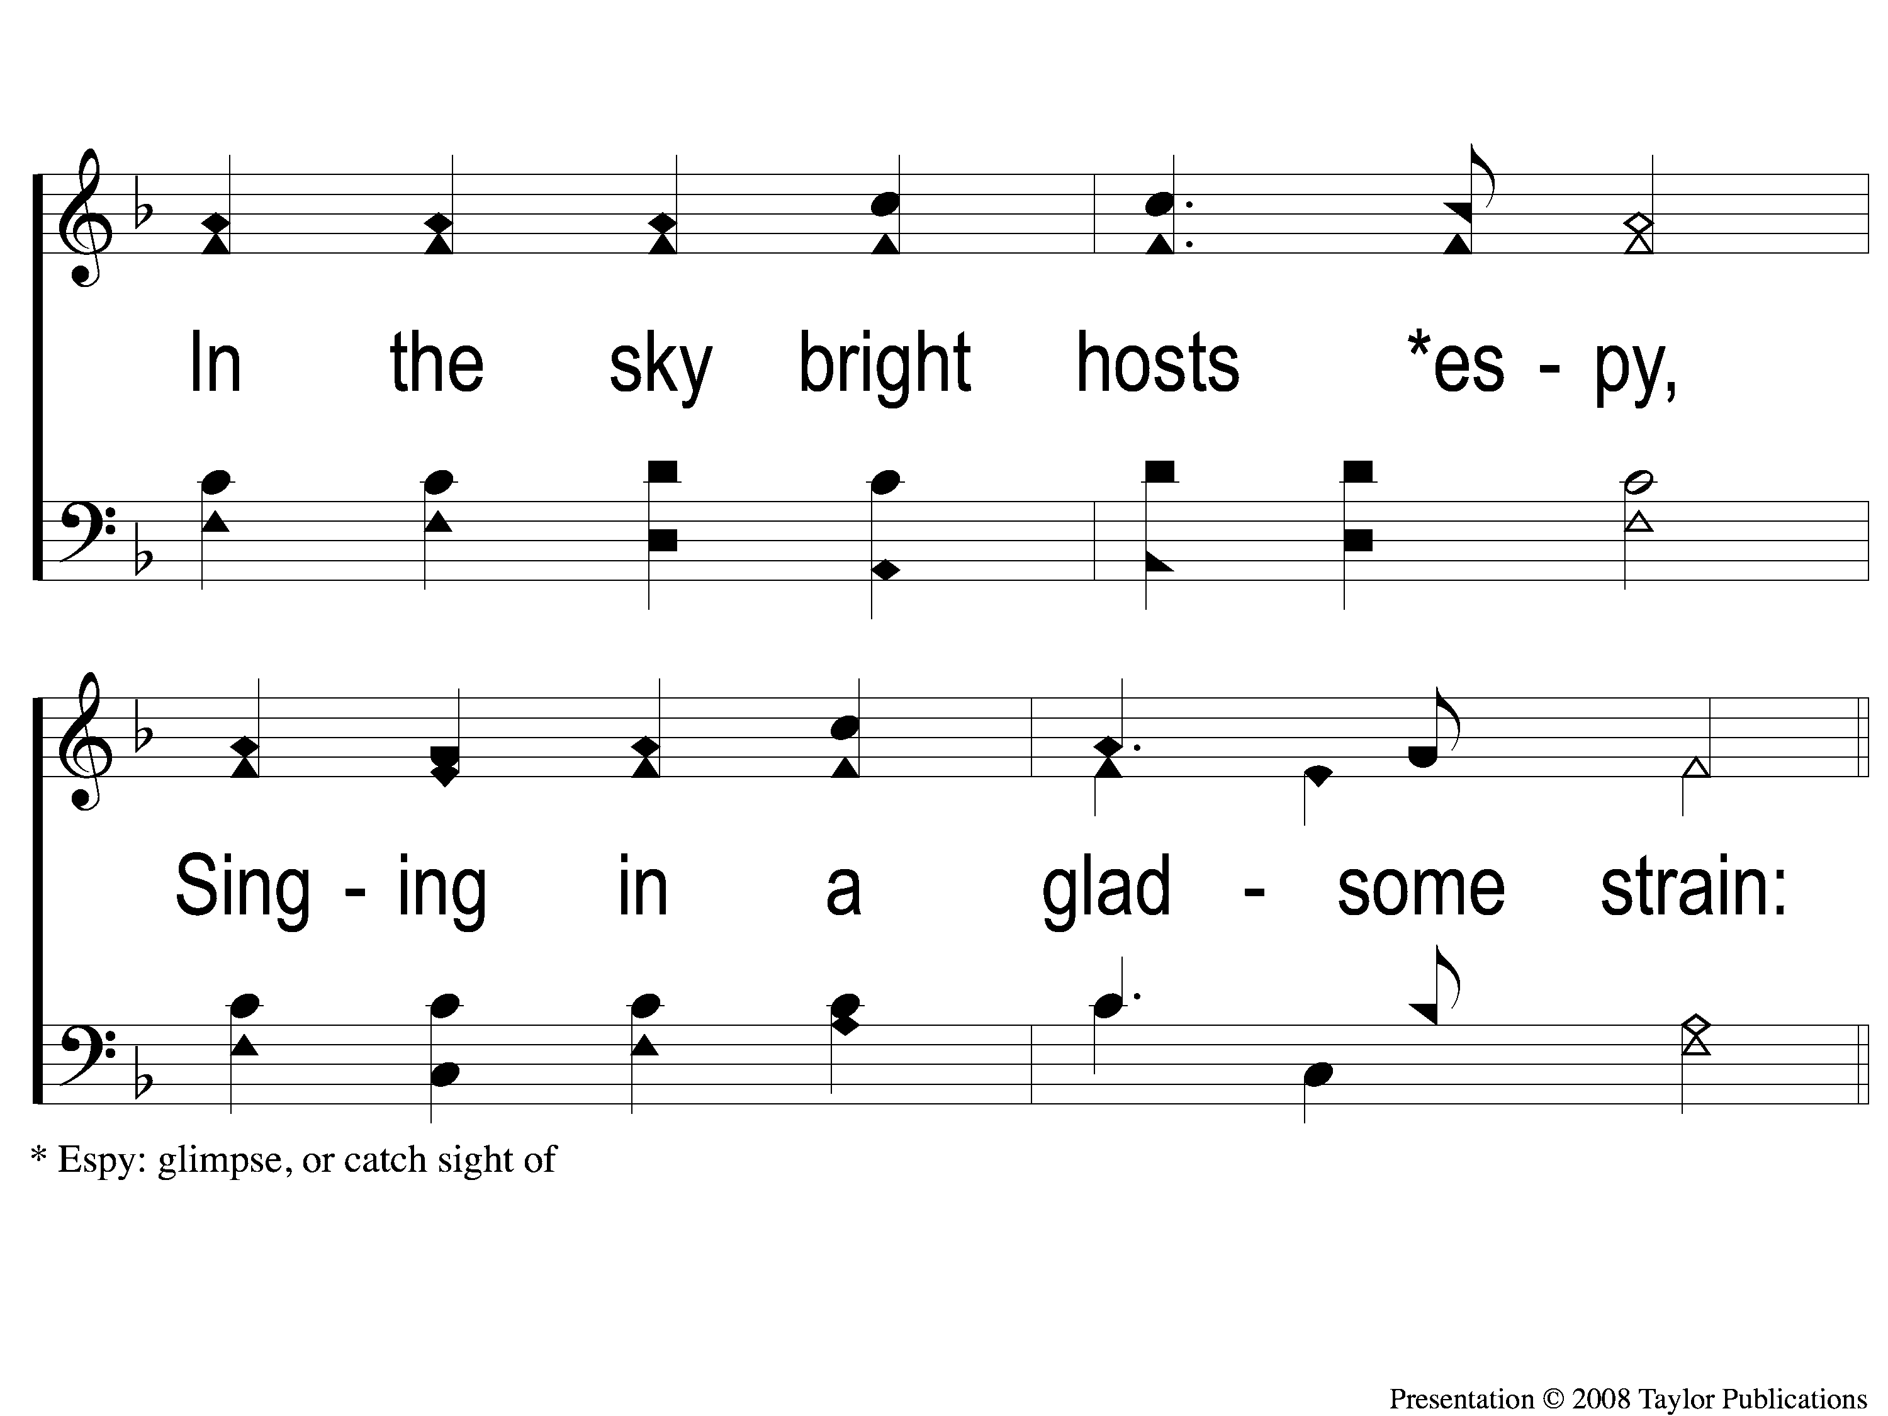
2-2 When the Crimson Sun is Set
When the Crimson Sun is Set
68

Slide 6
C When the Crimson Sun is Set
When the Crimson Sun is Set
68

